Slide 1
Introduction to Embedded Systems

Slide 2
Module Outline
Introduction to Embedded Systems
CPUs vs. MCUs vs. Embedded Systems
Examples of Embedded Systems
Options for Building Embedded Systems
Features of Embedded Systems
Introduction to Internet of Things (IoT)
What is IoT?
Why IoT?
Challenges of IoT
Building Embedded Systems
Building Embedded System using MCUs
Introduction to the mbedTM Platform

Slide 3
Introduction to Embedded Systems

Slide 4
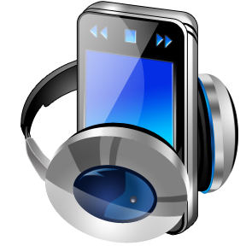

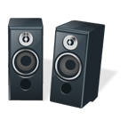
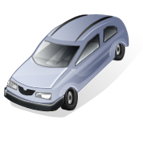
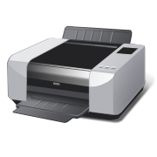
Introduction to Embedded Systems
What is an Embedded System?
Application-specific computer system
Built into a larger system
Often with real-time computing constraints
Why add a computer to a larger system?
Better performance
More functions and features
Lower cost e.g. through automation
More dependability
Embedded
System
Embedded Computer
Input from
Environment
Software
Output to Environment
Hardware
User Interface
Link to other Systems

Slide 5
CPUs vs. MCUs vs. Embedded Systems
Microprocessor (CPU)
Defined typically as a single processor core that supports at least instruction fetching, decoding, and executing
Normally can be used for general purpose computing, but needs to be supported with memories and Input/Outputs(IOs)
Instruction fetcher
Memory Interface
To memory
blocks
Instruction decoder
Register banks
ALU
Microprocessor

Slide 6
CPUs vs. MCUs vs. Embedded Systems
Microcontroller (MCU)
Typically has a single processor core
Has memory blocks, Digital IOs, Analog IOs, and other basic peripherals
Typically used for basic control purpose, such as embedded applications
Microprocessor
Program
Memory
Data
Memory
System Bus
Digital IO
Analog IO
Timer
Other peripheral
Microcontroller

Slide 7
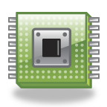
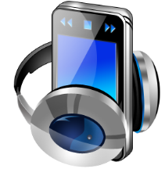
CPUs vs. MCUs vs. Embedded Systems
Embedded System
Typically implemented using MCUs
Often integrated into a larger mechanical or electrical system
Usually has real-time constraints
Embedded
System

Slide 8
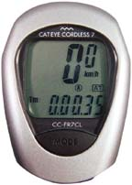
Example Embedded System: Bike Computer
Functions
Speed and distance measurement
Constraints
Size
Cost
Power and Energy
Weight
Inputs
Wheel rotation indicator
Mode key
Output
Liquid Crystal Display
Use Low Performance Microcontroller
8-bit, 10 MIPS
Input:
Wheel rotation
Mode key
Output:
Display speed and distance

Slide 9
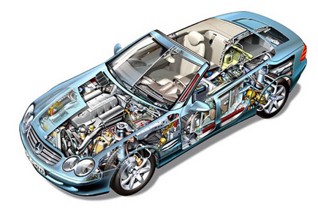
Gasoline Automobile Engine Control Unit
Functions
Fuel injection
Air intake setting
Spark timing
Exhaust gas circulation
Electronic throttle control
Knock control
Constraints
Reliability in harsh environment
Cost
Weight
Many Inputs and Outputs
Discrete sensors & actuators
Network interface to rest of car
Use High Performance Microcontroller
E.g. 32-bit, 3 MB flash memory, 150 - 300 MHz

Slide 10
Options for Building Embedded Systems
Implementation | Design Cost | Unit Cost | Upgrades & Bug Fixes | Size | Weight | Power | System Speed
Discrete Logic | low | mid | hard | large | high | ? | very fast
ASIC | high ($500K/ mask set) | very low | hard | tiny - 1 die | very low | low | extremely fast
Programmable logic – FPGA, PLD | low to mid | mid | easy | small | low | medium to high | very fast
Microprocessor + memory + peripherals | low to mid | mid | easy | small to med. | low to moderate | medium | moderate
Microcontroller (int. memory & peripherals) | low | mid to low | easy | small | low | medium | slow to moderate
Embedded PC | low | high | easy | medium | moderate to high | medium to high | fast
Dedicated Hardware
Software Running on Generic Hardware

Slide 11
Benefits of Embedded Systems
Greater performance and efficiency
Software makes it possible to provide sophisticated control
Lower costs
Less expensive components can be used
Manufacturing costs reduced
Operating costs reduced
Maintenance costs reduced
More features
Many not possible or practical with other approaches
Better dependability
Adaptive system which can compensate for failures
Better diagnostics to improve repair time

Slide 12
Functions of Embedded Systems
Closed-loop control system
Monitor a process, adjust an output to maintain desired set point (temperature, speed, direction, etc.)
Sequencing
Step through different stages based on environment and system
Signal processing
Remove noise, select desired signal features
Communications and networking
Exchange information reliably and quickly
Notes:
Замкнутая система управления
Контроль и регулирование (поддержание) заданных значений (температуры, скорости, направления и т.д.)

Slide 13
Attributes of Embedded Systems
Interfacing with larger system and environment
Analog signals for reading sensors
Typically use a voltage to represent a physical value
Power electronics for driving motors, solenoids
Digital interfaces for communicating with other digital devices
Simple - switches
Complex – displays
Concurrent, reactive behaviours
Must respond to sequences and combinations of events
Real-time systems have deadlines on responses
Typically must perform multiple separate activities concurrently

Slide 14
Attributes of Embedded Systems
Fault handling
Many systems must operate independently for long periods of time, requiring them to handle likely faults without crashing
Often fault-handling code is larger and more complex than the normal-case code
Diagnostics
Help service personnel determine problems quickly

Slide 15
Constraints of Embedded Systems
Cost
Competitive markets penalize products which don’t deliver adequate value for the cost
Size and weight limits
Mobile (aviation, automotive) and portable (e.g. handheld) systems
Power and energy limits
Battery capacity
Cooling limits
Environment
Temperatures may range from -40°C to 125°C, or even more

Slide 16
Impact of Constraints
Microcontrollers used (rather than microprocessors)
Include peripherals to interface with other devices, respond efficiently
On-chip RAM, ROM reduce circuit board complexity and cost
Programming language
Programmed in the C language rather than the Java language (resulting in smaller and faster code, so less expensive MCU)
Some performance-critical code may be in assembly language (a lower level language)
Operating system
Typically no OS, but instead simple scheduler (or even just interrupts + main code (foreground/background system)
If OS is used, likely to be a lean RTOS

Slide 17
Introduction to Internet of Things (IoT)

Slide 18

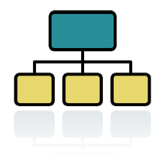

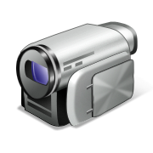


Internet of Things
Internet of Things (IoT)
IoT as a term generally refers to a world in which a large range of objects are addressable via the network
Objects can include
Smart buildings and home appliances, e.g. washing machines, TVs, fridges, cookers, doors, chairs…
Civil engineering structures, e.g. bridges, railways …
Wearable devices, e.g. smart watches, smart glasses, rings, clothes …
Medical devices, e.g. embedded pills
And possibly every THING in the world…
IoT

Slide 19
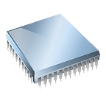

Internet of Things
Why IoT?
Items can have more functionalities and become more intelligent
Items can be managed in an easier way
More information become available
Why IoT is becoming more realistic?
Embedded chips are becoming
Cheaper
Smaller
Lower power
Communication is becoming faster

Slide 20
Challenges of Internet of Things
Large amount of chips required
Chips have to become even more cheaper, smaller
Big data demand
Large volume of data will be generated, data centre storage needs to be increased
Computation requirement
Requires high performance e.g. for cloud computing
Power consumption
Low power chips, longer battery life, and maybe wireless charging…
Security
Large amount of private data need to be protected
Standards
Official standards are required, such as network protocol

Slide 21
Building Embedded Systems

Slide 22
Building Embedded Systems using MCUs
In most embedded systems, MCUs are chosen to be the best solution, since they offer:
Low development and manufacturing cost
Easy porting and updating
Light footprint
Relatively low power consumption
Satisfactory performance for low-end products
In the following labs, we will learn how to develop a variety of embedded systems, using an easy-to-start MCU design suite: mbedTM platform
Open software library tools
Low cost hardware platforms
Online Integrated development environment (IDE)

Slide 23

What is mbed Platform
mbed is a platform used for developing applications based on ARM Cortex-M microprocessors
The mbed platform includes:
mbed Software Development Kit (SDK), consists of
C/C++ software libraries, such as peripheral drivers, networking, RTOS and runtime environment
Software tools, such as build tools, test and debug scripts
mbed Hardware Development Kit (HDK), consist of
Recipes to build custom hardware devices, such as interface firmware and schematics that can be used to easily create development boards
mbed hardware platforms – off-the-shelf development boards
mbed supports an online IDE, which provides a free instant-access web-based toolchain for application development

Slide 24






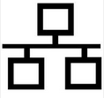

Coming Next…
Knowledge of embedded systems
Hardware mechanisms
Introducing the mbed platform
Introducing the ARM Cortex-M Architecture
Use Interrupt for low power design
Software programming
Programming basics: assembly, C/C++ programing
Learn to use software libraries: CMSIS, mbed APIs
Develop your own embedded systems
Analog IOs: ADC, DAC, PMW
Serial communication: UART, I2C, SPI
Advanced serial communication: USB, CAN, Bluetooth LE
Network: Ethernet, TCP/IP, HTTP
Real-time operating system
Prototyping applications for Internet of Things

Slide 25
Useful Resources
mbed official website:
http://www.mbed.org

